Slide 1
MyCourses – a Course Scheduling Problem
and a Softwareengineering Project

Slide 2
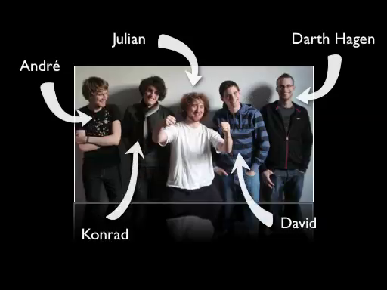
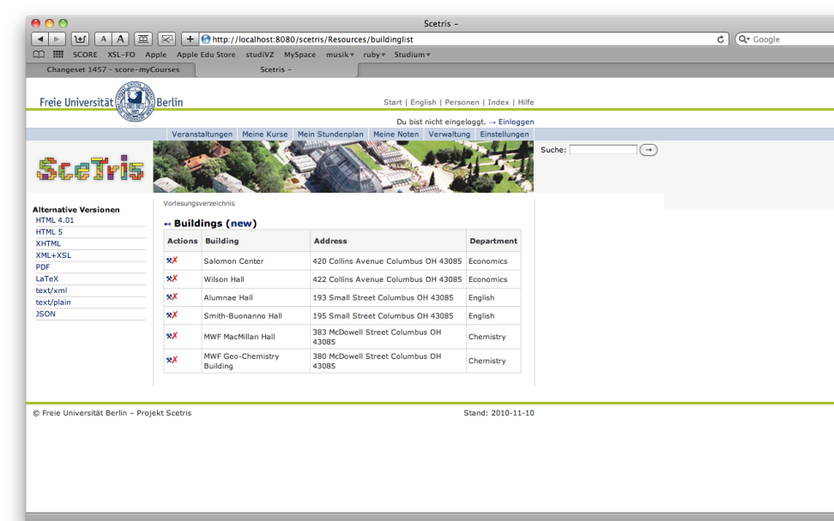
SceTris
Team
Web Application

Slide 3
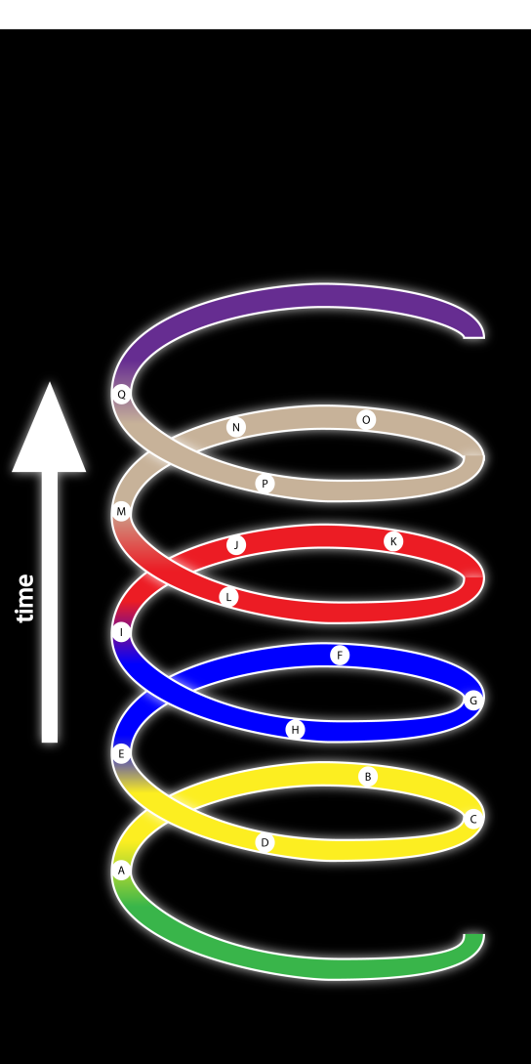
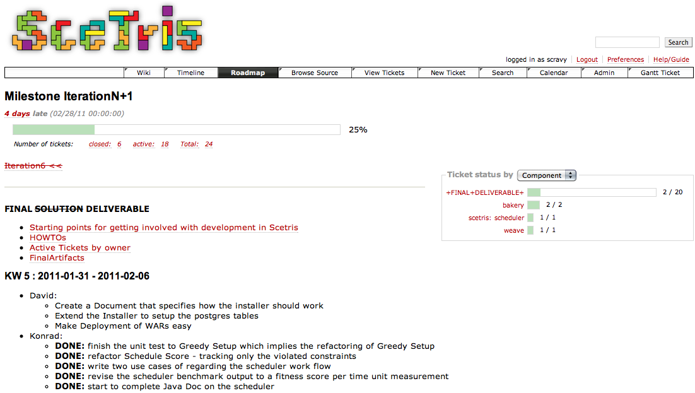
Team Management

Slide 4
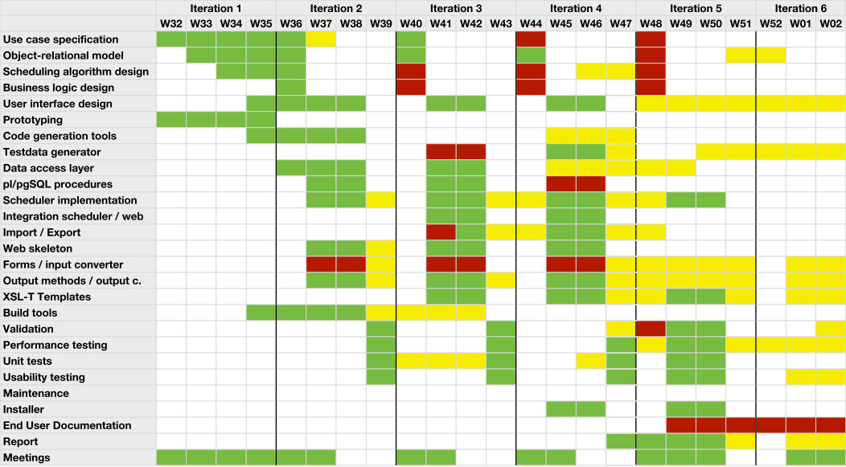
Time management

Slide 5
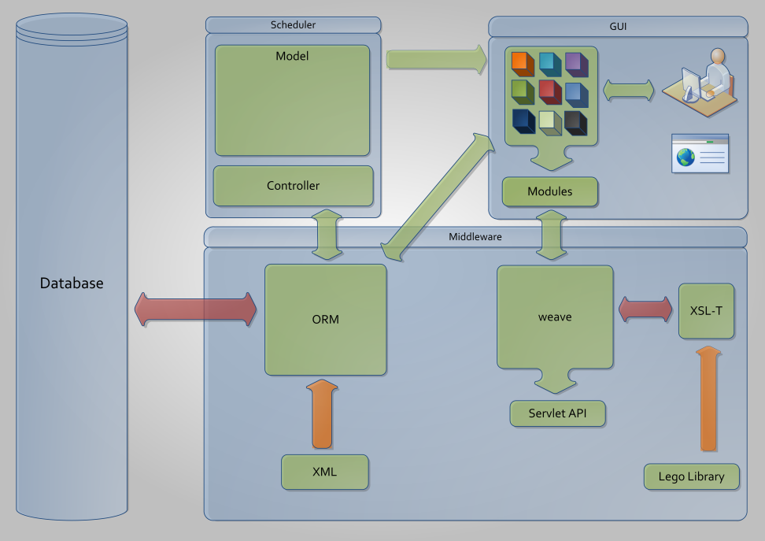
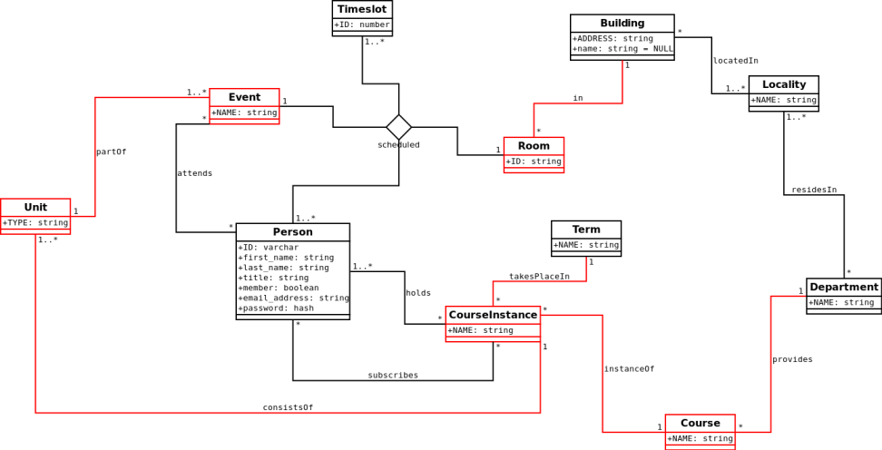
Technologies

Slide 6
Detail Magic-Stuff
Awesomeness Generator
Awesomeness Generator 2.0

Slide 7
Features
Bäm
BäBääm
Uiiii
BadaBaDäm

Slide 8
Project from the human POV
Stuff learned
Lessons learned
Other humanity related stuff
Project related stuff that the humans learned

Slide 9
Where we are/ where it goes
stuff we achieved
stuff we did not achieved
other achievement related stuff

Slide 10
Summary
Questions about our awesomeness

